Slide 1
Case Study – Emission Projections for Colorado Regional Haze SIP
Regional Haze Teach-in #3
August 31, 2017
Curt Taipale – Planning Policy Program
Dale Wells – Technical Services Program

Slide 2
Role of Emission Inventories in RH Process
Baseline
Produce an accurate baseline emission inventory for replicating existing visibility conditions
Future Projections
Adjust baseline emissions to reflect on-the-books and on-the-way controls and other anticipated changes to visibility related emissions
Calibrate RH Model to baseline emissions and observe the relative response to incremental changes to projected emissions.
Modeled future visibility used to establish CIA reasonable progress goals

Slide 3
Colorado’s Data System
Point sources required to report emissions at least every 5 years
Pollutant | APEN Threshold -Attainment Area (tpy) | APEN Threshold -Non Attainment Area (tpy) | Permit Threshold –Attainment Area (tpy) | Permit Threshold- Non Attainment Area (tpy)
CO/NOx/SO2 & TSP | 2 | 1 | 10 | 5
PM-10 & PM-2.5 | 2 | 1 | 5 | 1
VOC | 2 | 1 | 5 | 2

Slide 4
Sources of Emission Data for Colorado
Point Sources
EGUs – Baseline use CAMD reported data, Projections use EIA regional power projections and added EGUs to meet forecasted demand
Oil and Gas use Colorado APEN data and custom approach for tanks
Mobile Sources
On-road
EPA MOVES Model
Non-road
EPA Nonroad Model
Area
EPA National Emissions Inventory (NEI)
Oil and Gas Area sources based on basin specific studies

Slide 5
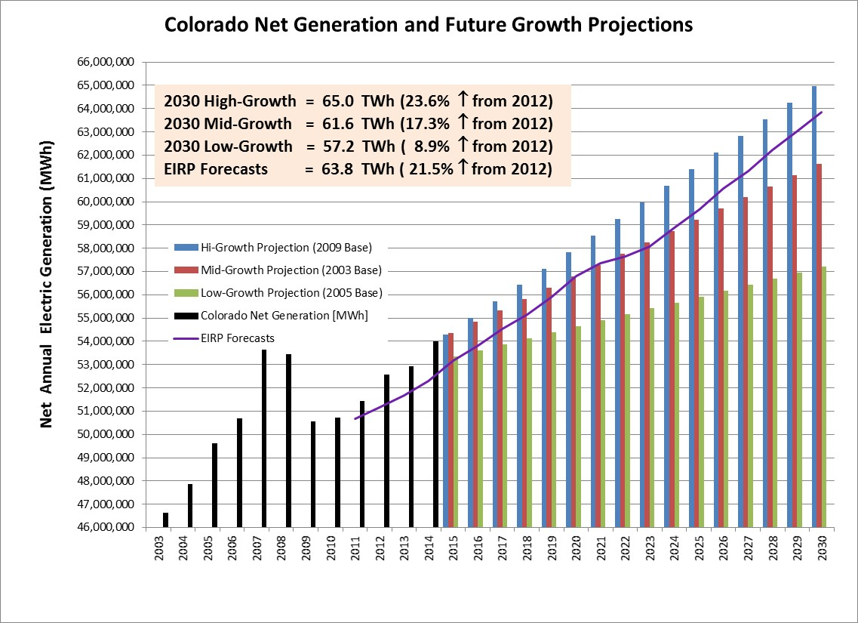

Slide 6
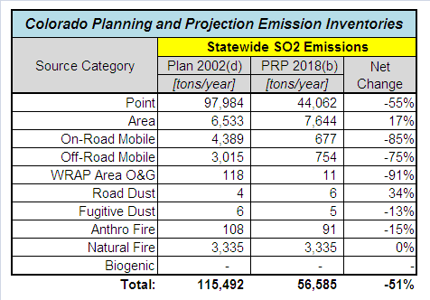
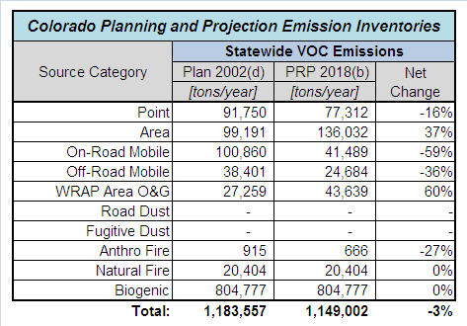
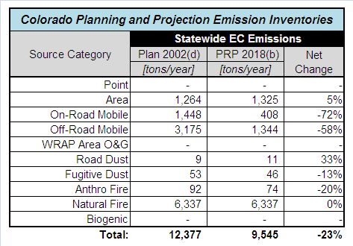
Colorado RH Emission Inventories

Slide 7
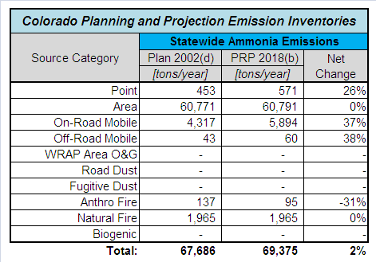
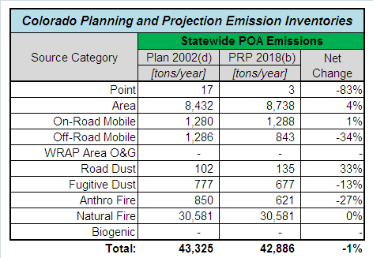
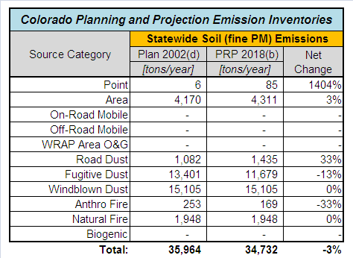
Colorado RH Emission Inventories

Slide 8
Consequences of the Evolution of Oil and Gas Control and Production Technology in the Denver Ozone Nonattainment Area
Dale Wells
Modeling, and Emission Inventory Unit
Technical Services Program
Air Pollution Control Division
Colorado Department of Public Health and Environment
dale.wells@state.co.us

Slide 9
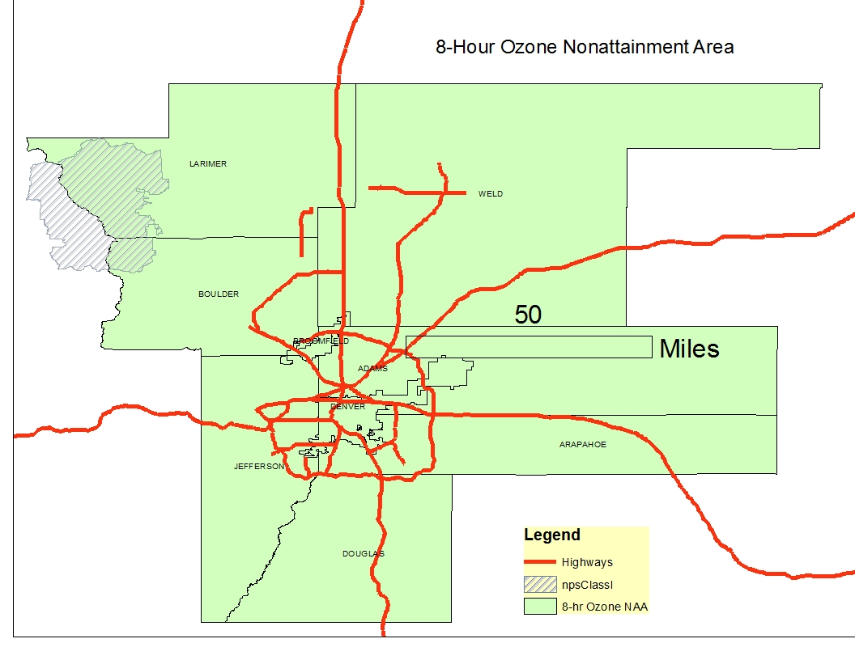
Map of Denver Metropolitan/North Front Range (DMA/NFR) Ozone Nonattainment Area (NAA)
~11,000 Square Miles – about the size of Connecticut

Slide 10
Emissions Inventory Guidance for Implementation of Ozone and Particulate Matter National Ambient Air Quality Standards (NAAQS) and Regional Haze Regulations, EPA-454/B-17-002
The general equation for emissions estimation is:
Emissions = A × EF × (1−ER/100)
A = activity total
EF = emission factor
ER = overall emission reduction efficiency (%)

Slide 11
The ER term is related to emissions controls and rules that reduce emissions (all are percentages less than 100)
Control Data Elements
Control efficiency: the efficiency by which a control device or measure reduces emissions for a particular pollutant.
Control Capture efficiency: portion of an exhaust gas stream actually collected for routing to a set of control devices.
Control Effectiveness: amount time or activity throughput that a control approach is operating as designed, including the capture and reduction devices.
Rule penetration: amount of a nonpoint source category activity that is covered by the reported control measures.
Rule effectiveness: a rating of how well a regulatory program achieves all possible emissions reductions.

Slide 12
Inventory Development for the 2017 Ozone SIP: 2011 Base Year Inventory
Condensate Tanks
Equation (2) Emissions (lbs) = 2011 Oil Production (bbls) X 13.7(lbs/bbl) X $\left(1−(90\%×97.7\%×80\%×75\%)\right)$
= 2011 Oil Production (bbls) X 13.7(lbs/bbl) X 0.472
Base Year 2011 oil and gas condensate tank emissions
 | 2011 (tpd)
Pollutant | VOC | NOx | CO
Condensate Tank Emissions | 216.0 | 1.1 | 2.3

Slide 13
2011 oil and gas well pad source emissions
Table 4. 2011 oil and gas well pad source emissions
 | 2011 (tpd)
Oil and Gas Area Sources | VOC | NOx | CO
Drill rigs | 0.7 | 11.3 | 5.9
Exempt engines | 0.6 | 8.1 | 5.2
Fugitives | 21.3
Heaters | 0.1 | 1.6 | 1.3
Misc. (spills, workover rigs, etc.) | 0.5 | 1.3 | 0.5
Pneumatic devices | 11.8
Pneumatic pumps | 2.4
Truck loading of condensate liquid | 3.8
Venting - blowdowns | 4.6
Venting - initial completions and recompletions | 3.2
Water tank losses | 0
Subtotal | 48.9 | 22.2 | 12.9

Slide 14
2011 oil and gas point source emissions
2011 (tpd)
VOC | NOx | CO
14.8 | 18.1 | 17.0

Slide 15
Attainment Year Inventory
Until 2013, most of the oil and gas production in the NAA had been from vertical wells drilled in the sandstone formations. Since 2013, almost all of the new production has been in the Niobrara Shale formations, utilizing horizontal drilling and hydraulic fracturing (fracking).

Slide 16
Development of Attainment Year Inventory
APCD and Regional Air Quality Council staff met numerous times with the top 6 oil producers.
These producers provided their 2014 activity and emission data for all of their well pad facilities, and projected oil production to the 2017 attainment year.
We accepted the non-condensate tank data as submitted.
We modified the 2017 condensate tank emissions based on Equation (1) .
We developed uncontrolled emission factors for each of the following configuration of well pads based on the 2014 data:
Tankless
Vertical Wells
1 stage of separation
2 stages of separation
Horizontal Wells
1 stage of separation
2 stages of separation
3 stages of separation

Slide 17
2017 VOC emissions inventory - oil and gas condensate Tanks
 | Well Type | Stages of Separation | 2014 Oil Production | 2017 Oil Production | 2014 Uncontrolled Emissions Factors | 2017 Uncontrolled Emissions | Control Rate (%) | 2017 Controlled Emissions (tpd)
 |  |  | (MMbbl) | (MMbbl) | (lbs/bbl) | (tpd) |  | (tpd)
All Producers in 9-County Area | Horizontal | 1 | 13.4 | 9.9 | 7.27 | 98.1 | 74.70% | 24.8
 |  | 2 | 20.2 | 46.7 | 2.01 | 128.9 | 77.40% | 29.1
 |  | 3 | 26.4 | 26.7 | 0.96 | 35.2 | 77.40% | 8
 |  | Total | 70.2 | 135.5 |  | 262.2 |  | 61.9
 | Vertical | 1 | 7.8 | 6.1 | 9.67 | 80.8 | 74.70% | 20.4
 |  | 2 | 3.0 | 2.0 | 7.71 | 21.6 | 77.40% | 4.9
 |  | 3 | 0.0 | 0.0 | -- | 0 | 77.40% | 0
 |  | Total | 10.8 | 8.1 |  | 102.4 |  | 25.3
 | TOTAL |  | 81.0 | 143.7 |  | 364.6 |  | 87.2
Note: Horizontal/Vertical breakdown is according to the wellpad having any horizontal wells. $2017 Emissions = Production ×\text{EF}\text{(}\text{lbs}\text{/}\text{bbl}\text{) }\text{X} \left(1−(90\% X CE X RE X RP)\right)$
For 1 Stage Of Separation $CE X RE X RP$ = 83%, For 2 & 3 Stages of Separation $CE X RE X RP$ = 86%

Slide 18
Oil production below ground breakdown for Weld County

Slide 19
Summary of 2011 and 2017 Oil and Gas emissions (tons per day) in the ozone NAA
Description | 2017 |  |  | 2011
 | VOC | NO_{X} | CO | VOC | NO_{X} | CO
Oil and Gas Sources
Point Sources Subtotal | 16.3 | 20.6 | 19.7 | 14.8 | 18.1 | 17
Condensate Tanks Subtotal | 78.7 | 0.6 | 2.3 | 216 | 1.1 | 2.3
Area Sources Subtotal | 59 | 44.6 | 31.4 | 48.9 | 22.2 | 12.9
TOTAL | 154 | 65.8 | 53.4 | 279.7 | 41.4 | 32.2

Slide 20
Top-Down Inventories:
The 2008 ozone SIP inventory was adjusted based in part on a top-down inventory by NOAA in 2012 that indicated oil and gas VOC emissions were underestimated by about a factor of two.
We developed the 2011 base year inventory that had condensate tank VOC emissions that were about four times larger than those reported by industry.
A new top-down inventory for 2012 published in 2013 by NOAA, indicates the 2017 ozone SIP base year inventory may also underestimate oil and gas VOC by a factor of two, and that benzene emissions may be underestimated by a factor of 7.
This is concerning, but APCD has been measuring 6 to 9 AM 3-hour samples of VOC species using Summa canisters at Platteville and Denver since 2012.
These data are good indicators of the primary VOC species emitted by local sources in these two areas since:
a) mixing is limited at those early hours and
b) the sun angle and temperatures are low so little photochemical reaction is occurring.
An analysis of this data set is probably a more robust way to determine the accuracy of the VOC inventory.

Slide 21
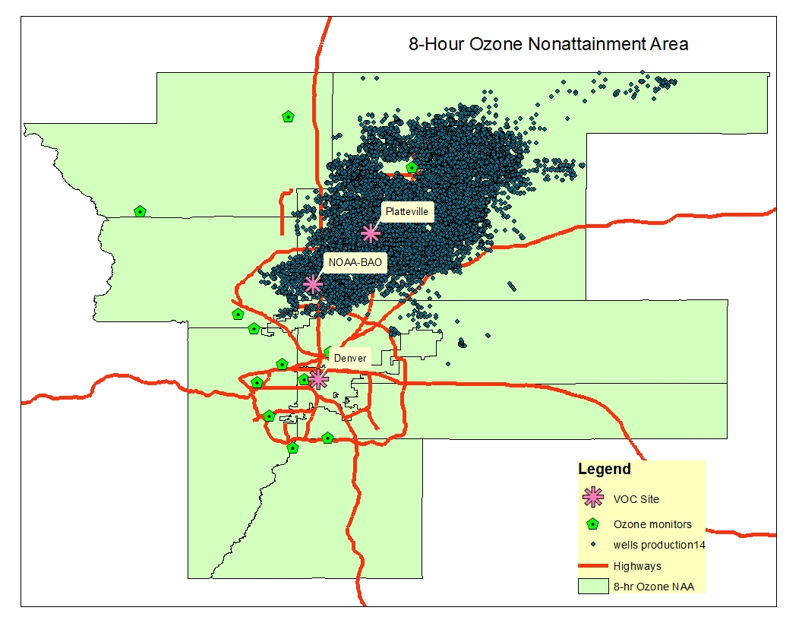
VOC Precursor Analysis:
VOC sample locations

Slide 22
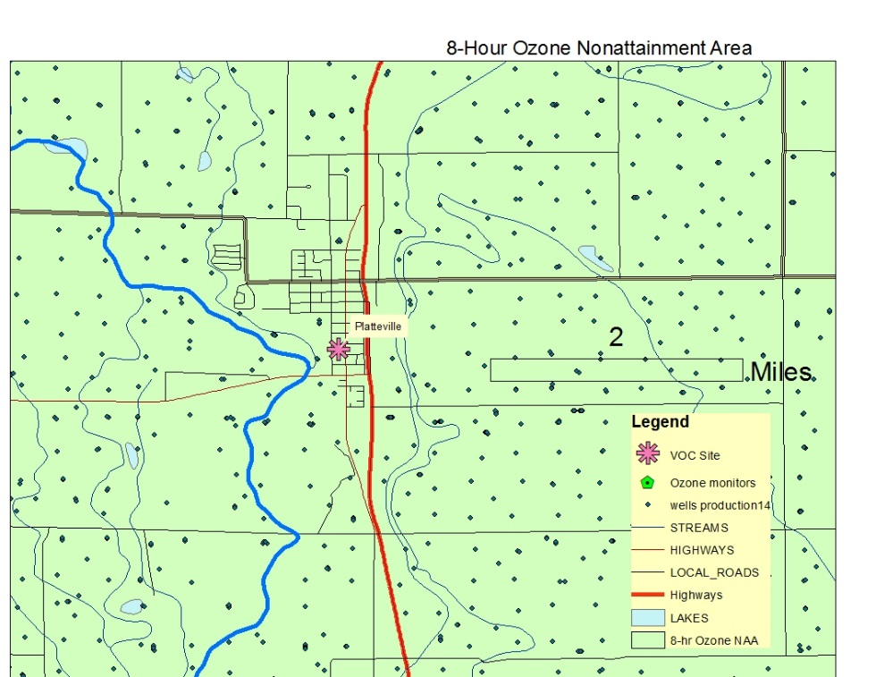
Platteville VOC site

Slide 23
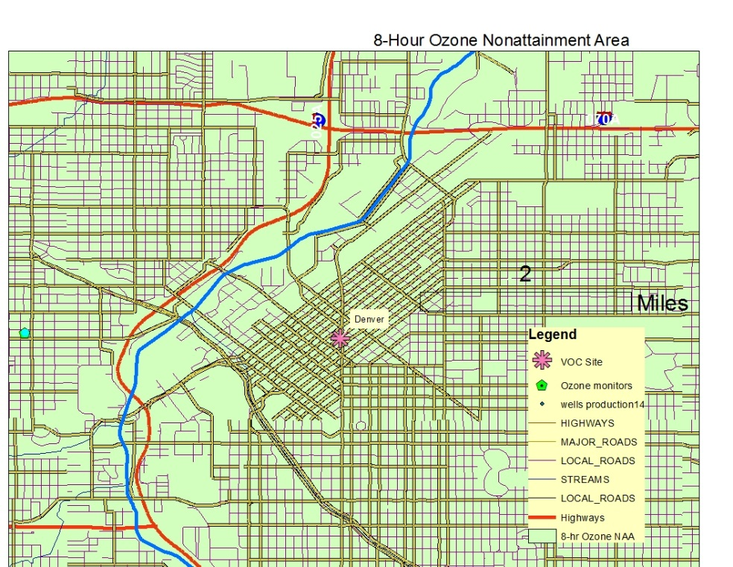
Denver VOC site

Slide 24
Annual average VOC at Platteville and Denver sites from 2012 to 2016

Slide 25
NMOC speciation profiles by weight percent |  |  |  | Platteville |  |  | Denver
DJFLA | DJVNT | NOAA BAO 2011 | Species | 2012 | 2015 | 2016 | 2012 | 2015 | 2016
32.6% | 24.7% | 22.4% | Propane | 26.5% | 25.1% | 25.7% | 16.5% | 13.2% | 13.4%
26.9% | 45.3% | 27.2% | Ethane | 23.3% | 23.0% | 26.1% | 21.6% | 22.9% | 30.4%
15.0% | 9.7% | 18.6% | n-Butane | 16.1% | 15.4% | 15.1% | 10.7% | 9.3% | 9.9%
8.3% | 5.1% | 8.0% | Isobutane | 6.9% | 6.3% | 6.7% | 4.3% | 4.3% | 3.9%
4.6% | 3.7% | 7.7% | n-Pentane | 6.6% | 6.5% | 5.9% | 6.2% | 6.7% | 4.4%
5.9% | 4.1% | 6.9% | Isopentane | 7.1% | 5.8% | 5.5% | 8.2% | 0.1% | 3.6%
 |  | 2.5% | Methylcyclopentane | 0.9% | 1.2% | 0.9% | 1.4% | 1.8% | 1.3%
3.3% | 7.1% | 2.2% | n-Hexane | 2.1% | 2.6% | 2.1% | 2.8% | 3.0% | 2.3%
2.5% | 0.0% | 0.7% | n-Heptane | 0.6% | 0.9% | 0.8% | 1.0% | 1.4% | 1.3%
0.2% | 0.2% | 0.6% | Toluene | 0.5% | 0.9% | 0.8% | 3.5% | 5.8% | 4.7%
0.2% | 0.1% | 0.5% | Benzene | 0.5% | 0.5% | 0.5% | 1.7% | 1.6% | 1.7%
 |  | 0.6% | Methylcyclohexane | 0.7% | 1.1% | 0.8% | 0.9% | 0.8% | 0.5%
 |  | 0.6% | Cyclohexane | 0.7% | 0.9% | 0.7% | 0.9% | 3.1% | 2.1%
 |  | 0.5% | Acetylene | 0.2% | 0.4% | 0.5% | 2.4% | 2.6% | 2.9%
 |  | 0.5% | Ethylene | 0.5% | 0.6% | 0.7% | 5.0% | 4.7% | 4.4%
0.1% | 0.1% | 0.3% | m/p Xylene | 0.2% | 0.4% | 0.3% | 1.8% | 2.5% | 1.8%
0.1% | 0.0% | 0.2% | 2,2,4-Trimethylpentane | 0.0% | 0.0% | 0.1% | 0.7% | 1.2% | 0.9%
 |  | 0.1% | o-Xylene | 0.1% | 0.1% | 0.1% | 0.7% | 1.1% | 0.7%
0.1% | 0.0% | 100.0% | n-Nonane | 0.1% | 0.2% | 0.1% | 0.3% | 0.5% | 0.4%
0.0% | 0.0% |  | n-Decane | 0.0% | 0.2% | 0.1% | 0.4% | 0.6% | 0.4%
0.0% | 0.0% |  | Ethylbenzene | 0.1% | 0.1% | 0.1% | 0.6% | 0.9% | 0.6%
0.4% | 0.0% |  | n-Octane | 0.2% | 0.5% | 0.3% | 0.5% | 0.7% | 0.6%
0.0% | 0.1% |  | Cyclopentane | 0.4% | 0.4% | 0.3% | 0.5% | 0.6% | 0.4%
100.0% | 100.0% |  |  | 94.3% | 93.1% | 94.4% | 92.5% | 89.4% | 92.4%

Slide 26
Change in emissions compared with change in VOC concentrations
% change from 2012
% Change from 2011
Weld County NEI Total O&G
% Change from 2011

Slide 27
Annual average benzene (ug/m3) and percent change from 2012

Slide 28
CONCLUSIONS
The top-down inventory conclusions that the base year inventory may be twice as high for VOC and seven times higher for benzene do not seem to match the ambient data.
The WRAP speciation profile for benzene in flash emissions does seem to be low by a factor of three.
Condensate tank emissions are the largest category of VOC.
Controlling tanks provides over 80% of the total reduction in emissions from 2011 to 2017.
If there were some other unknown or poorly characterized source of VOC, the ambient VOC trend would not have tracked the total oil and gas emission trend as well.
Condensate emissions are large in the NAA because both oil and gas are produced in the same wells under conditions of high gas pressure resulting in high flash emissions rates.
Flash emissions are from gases dissolved in the oil that “flash” out of solution when the gas pressure is reduced to near ambient levels.
The use of two or three stages of separation combined with compressors allows most of the flash gas to be removed from solution before going into storage.
Oil or condensate in conjunction with high pressure gas is a subset of “wet gas”.

Slide 29
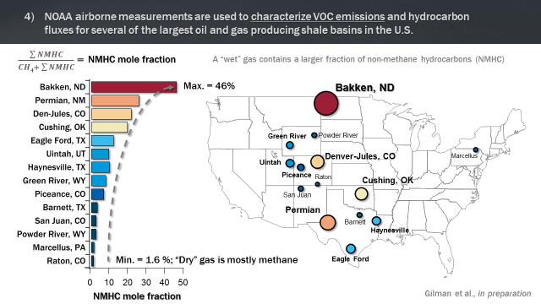
NMOC mole fractions at oil and gas shale basins.

Slide 30
CONCLUSIONS, Continued
Basins ranking above the San Juan may have significant condensate tank emissions.
To quantify these emissions, pressurized liquid samples should be obtained from the well pad separators to calculate a valid uncontrolled emission rate.
Without such samples the EPA Oil and Gas Tool will not adequately represent emissions.
Good speciation profiles are also necessary to apportion VOCs for hazardous air pollutants and photochemical models.
Ambient Summa canister sampling is a good check on the pressurized liquid sampling , which is difficult perform.

